Slide 1
NSF/NASA
The role of taxonomic, functional, genetic, and landscape diversity in food web responses to a changing environment
2013-2018
Anthony R. Ives, UW-Madison
Volker C. Radeloff, UW-Madison
Kerry M. Oliver, University of Georgia
Jason P. Harmon, North Dakota State University

Slide 2
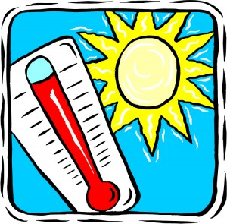
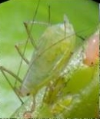

Slide 3
Matters of Scale
organization
genes

Slide 4
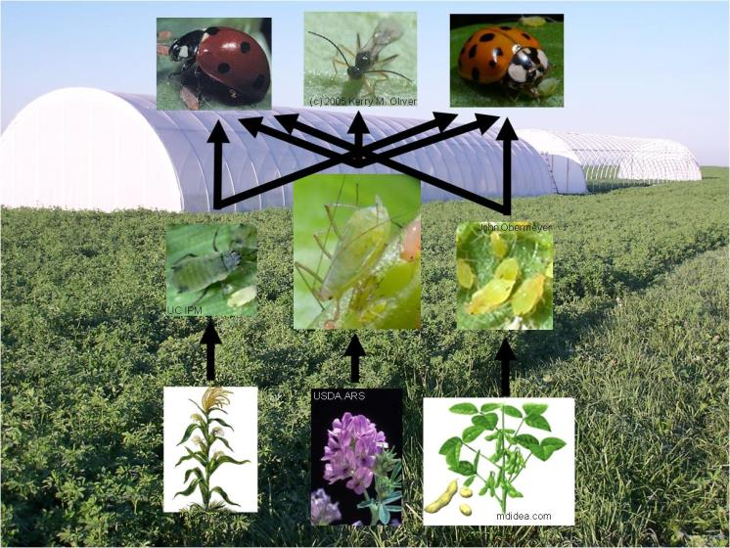

Slide 5
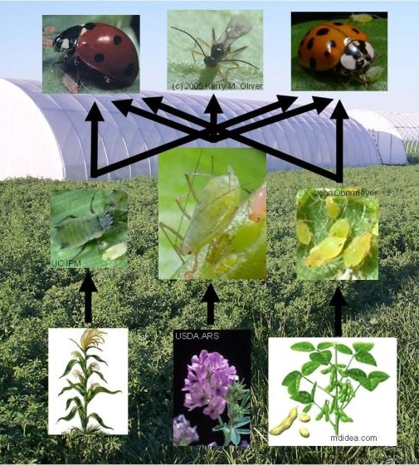
Matters of Scale
individuals
ecosystems
organization
genes

Slide 6
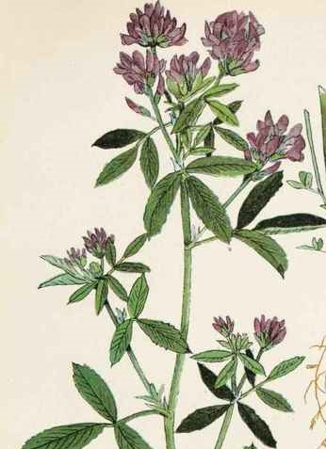
Matters of Scale
individuals
ecosystems
organization
genes
space
plants

Slide 7
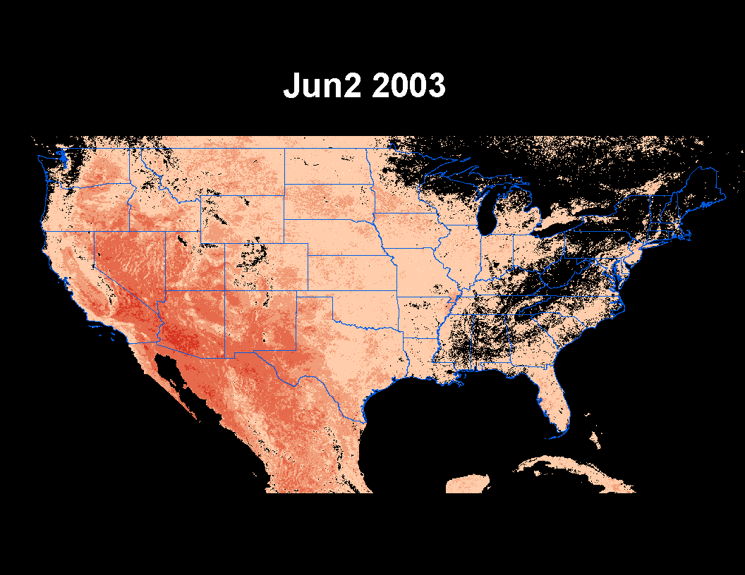

Slide 8
Matters of Scale
individuals
ecosystems
organization
genes
space
continents
plants

Slide 9


Matters of Scale
individuals
ecosystems
organization
genes
space
continents
plants
time
events
years

Slide 10
Matters of Scale
time
organization
space
The challenge is not just three dimensions,
but combinations of scales

Slide 11
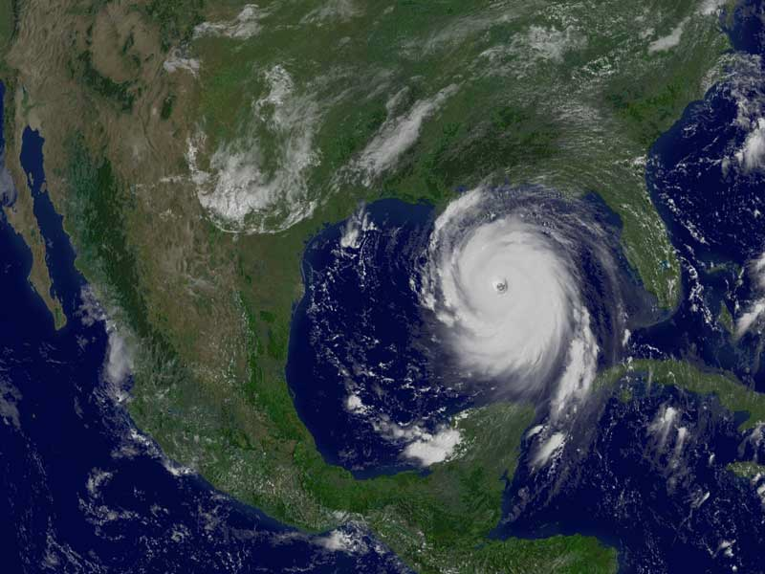
Hurricane Katrina (NASA)

Slide 12
time
organization
space
Fast environmental shocks affecting many species at broad spatial scales
Hurricane Katrina (NASA)

Slide 13
Project components
1. Rapid evolution to environmental change
2. Co-evolution among insects and bacterial symbionts
3. Effect of temperature on aphid populations and control by their natural enemies
4. interplay between ecological and evolutionary dynamics
time
organization
space

Slide 14
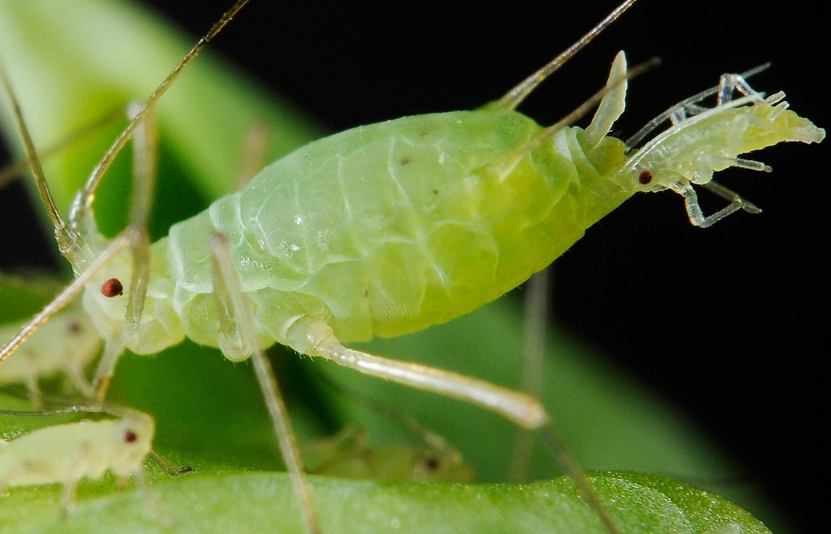
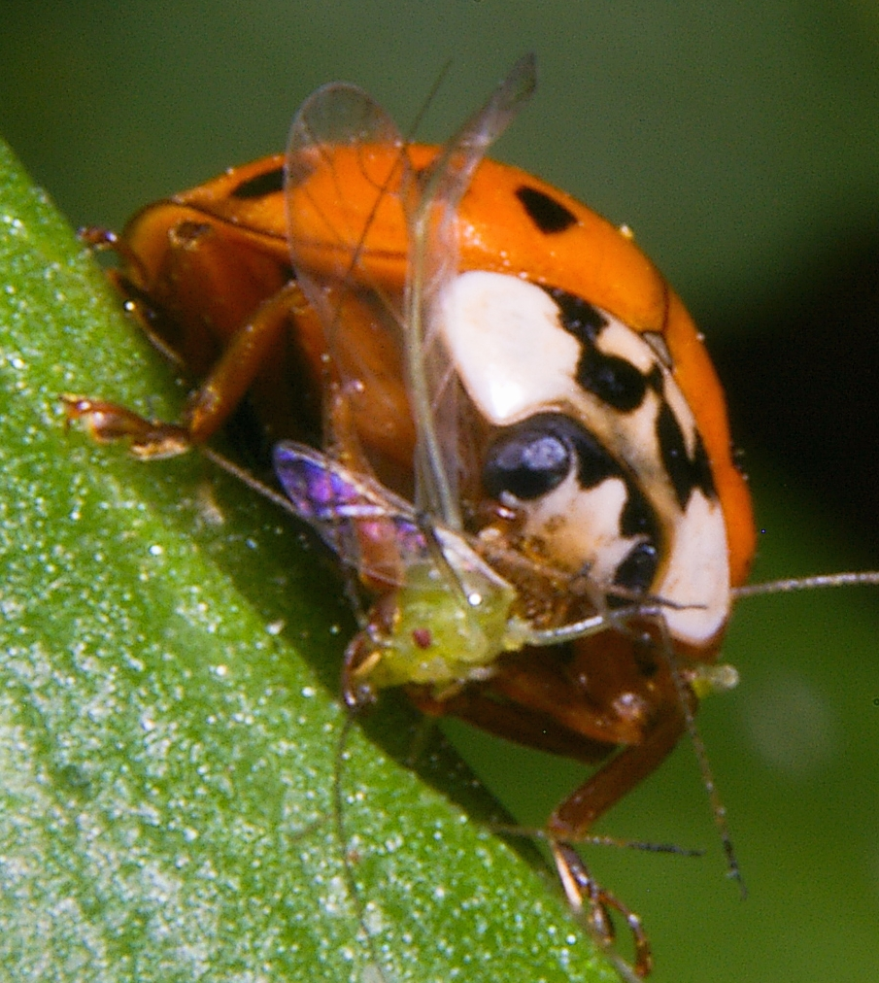
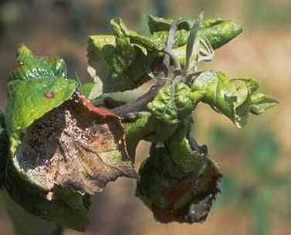
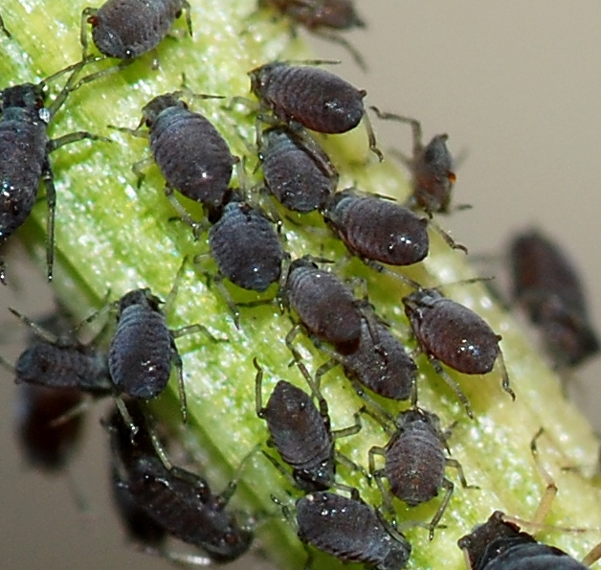
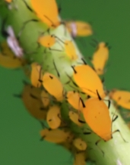
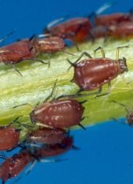
Aphids in agriculture as a model system

Slide 15
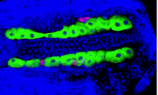
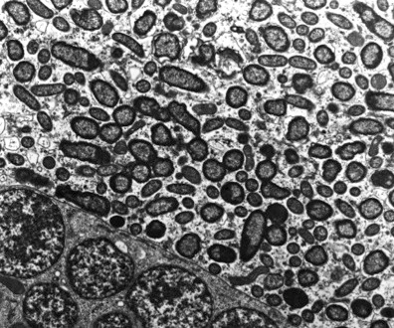
Bacterial symbionts
infect most insect species
heritable
part of the extended genome of insects
facultative
obligatory
from Kerry Oliver

Slide 16
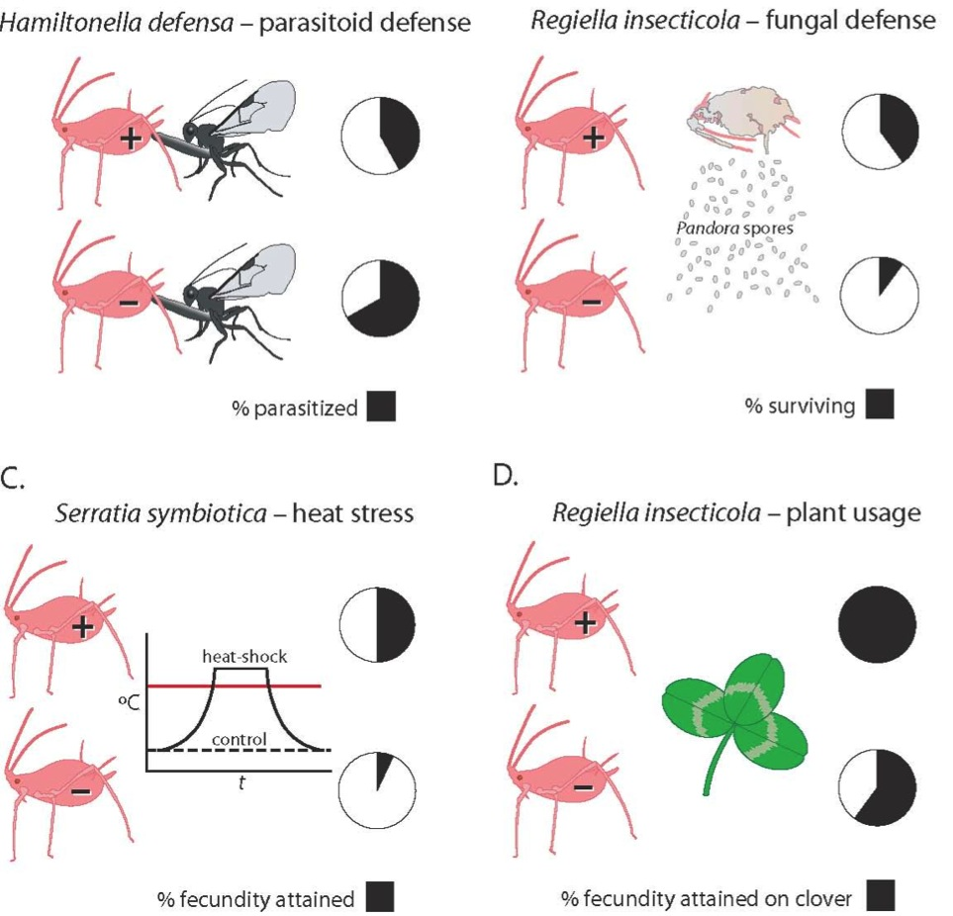
Pea aphid model system
Oliver et al. (2010 Ann. Rev. Entomol.)

Slide 17
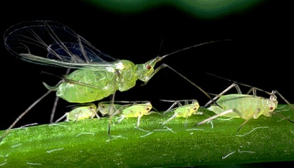
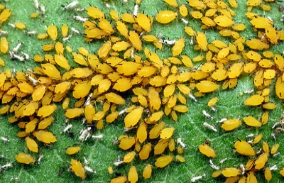
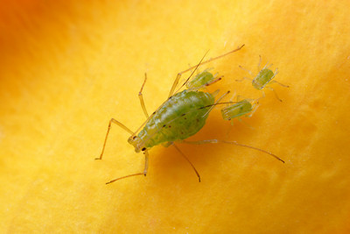
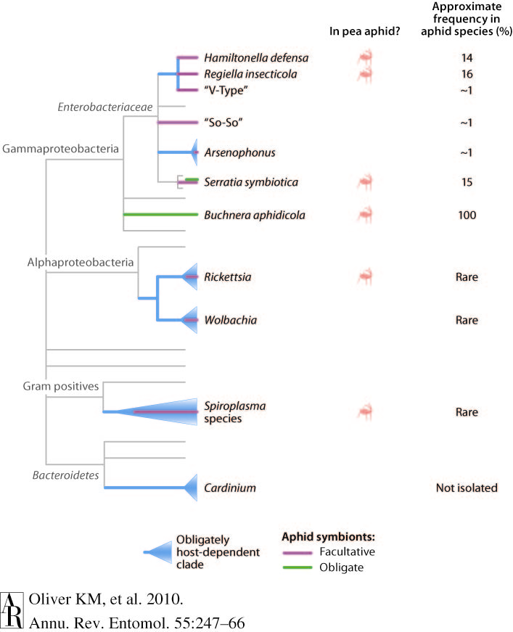
Many lineages of heritable symbionts in aphids
Photo credit: Alex Wild

Slide 18
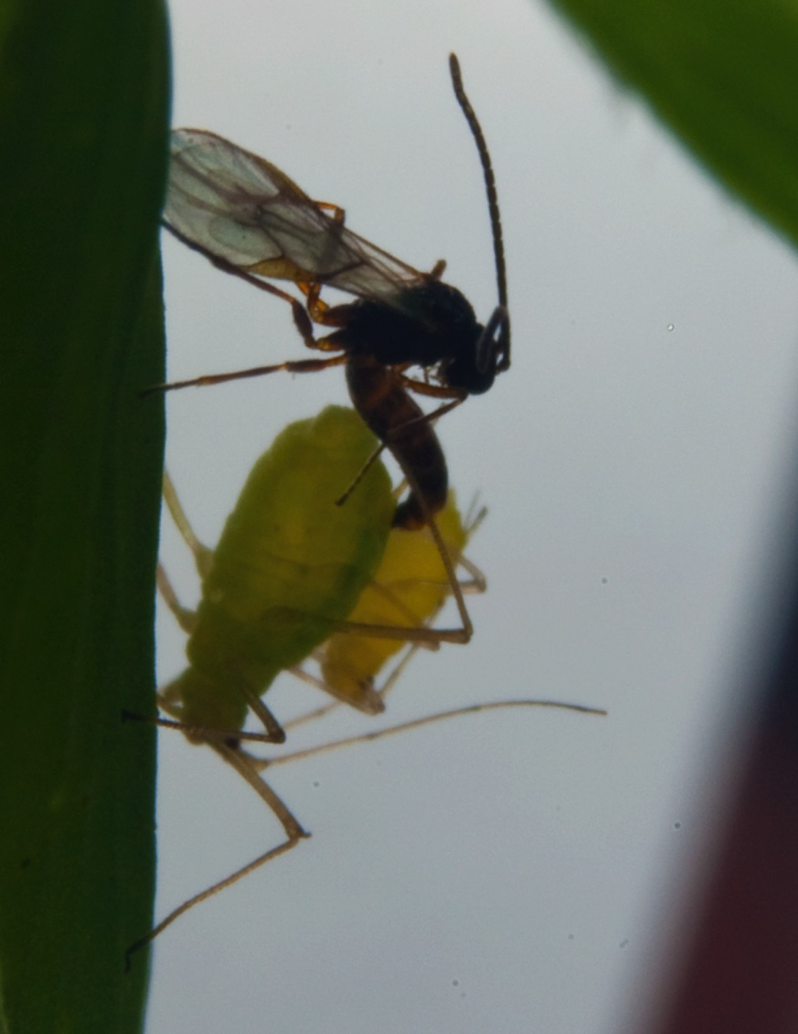
Parasitoids
develop within aphids and form a “mummy”
specialize on a small number of aphid species
often important biological control agents

Slide 19
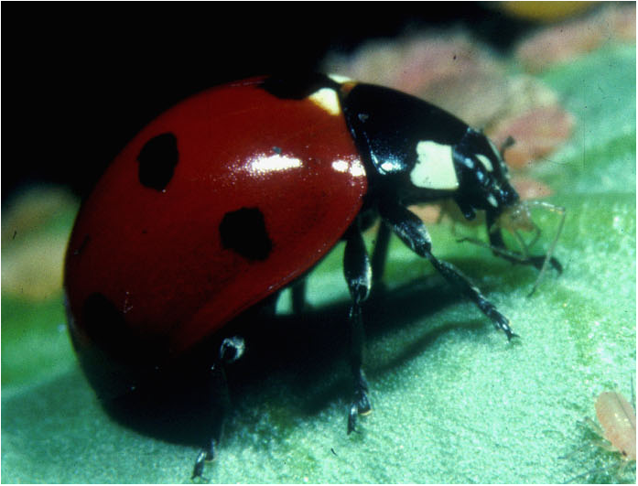
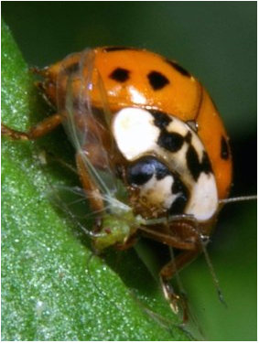
Ladybeetles
C7
Coccinella septempunctata
Europe/Asia
Harmonia
Harmonia axyridis
Asia

Slide 20
Project 3. Effect of temperature on aphid populations and control by their natural enemies
time
organization
space

Slide 21
Project 3. Effect of temperature on aphid populations and control by their natural enemies
time
organization
space

Slide 22
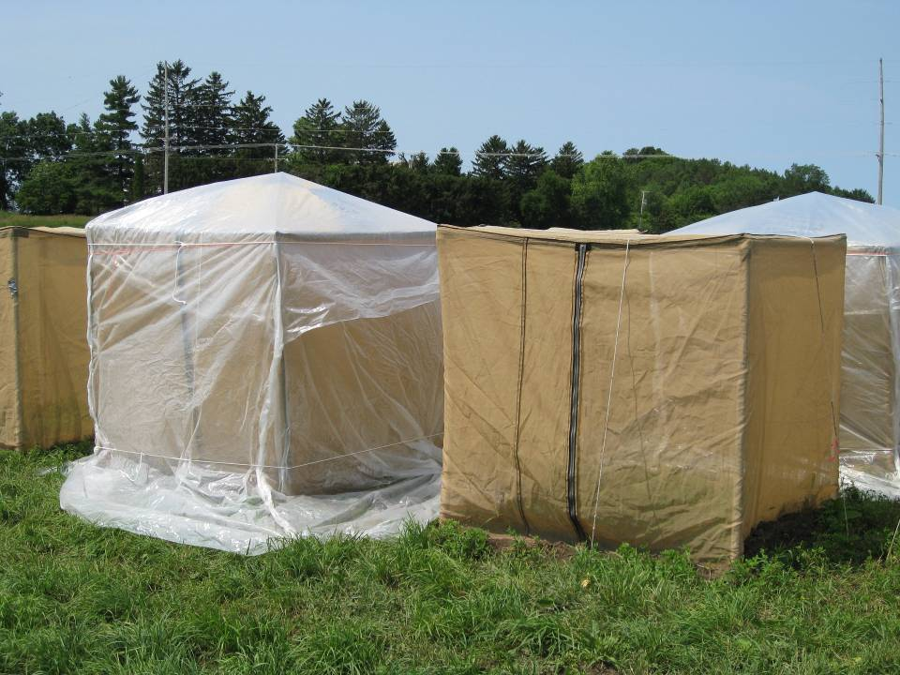
Small-scale temperature manipulation in the field
35
Temperature
20
8:00
20:00
8:00

Slide 23
Heat shock reduces aphid growth rate after a time lag
250
200
150
Total Aphids / Plant
100
50
0
0
2
4
6
8
10
12
14
16
Days

Slide 24
Project 3. Effect of temperature on aphid populations and control by their natural enemies
Long-term field surveys
time
organization
space

Slide 25
Field survey of pea aphids (5-10 fields/year)
Log aphid density, mean daily temperatures,
and heat shocks (daily max >30°C)

Slide 26
Log aphid density, mean daily temperatures, and heat shocks (>30°C)
time between samples
time of first sample
carrying capacity
population growth rate
occurrence of >30°C events 5-10 days before t
r₁ = 0.0012 (P = 0.35)
r₂ = -0.039 (P < 0.0001)
k = 0.56 (P < 0.0001)
Shocks are only significant when included with the
5-10 day delay

Slide 27
Project 3. Effect of temperature on aphid populations and control by their natural enemies
Long-term field surveys
Parasitoids and predators
time
organization
space

Slide 28
Do predators and parasitoids affect
how aphids respond to shocks?
(in progress)

Slide 29
Project 3. Effect of temperature on aphid populations and control by their natural enemies
Long-term field surveys
Parasitoids and predators
MODIS remote sensing
time
organization
space
Extrapolate from small-scale spatial processes to the broad scale

Slide 30
MODIS Land Surface Temperature
pink = 30°C occurred in 8-day window
redder = higher maximum daily temperatures
Notes:
Here are the heat maps (MODIS Land Surface Temperature). Everything in pink/red is more than 30 degrees, and the darker the color the hotter it is. Please feel free to invite Jason to the folder if you'd like.

Slide 31
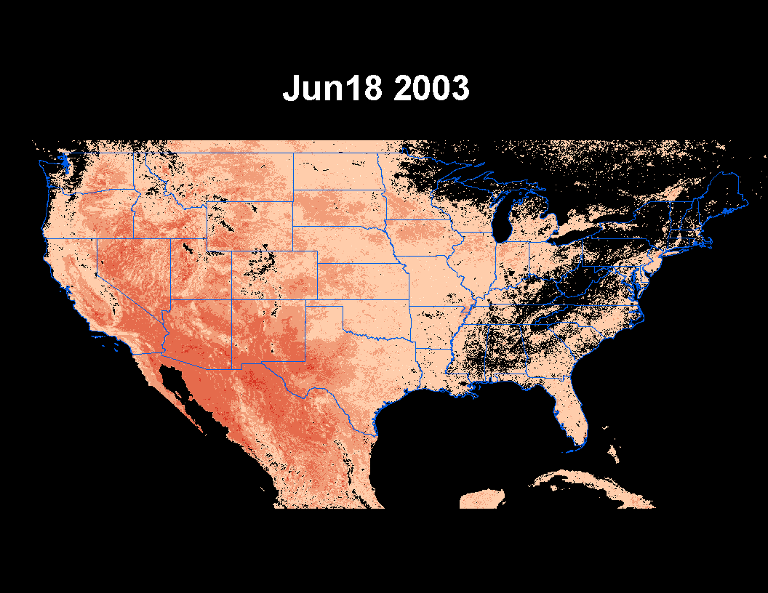
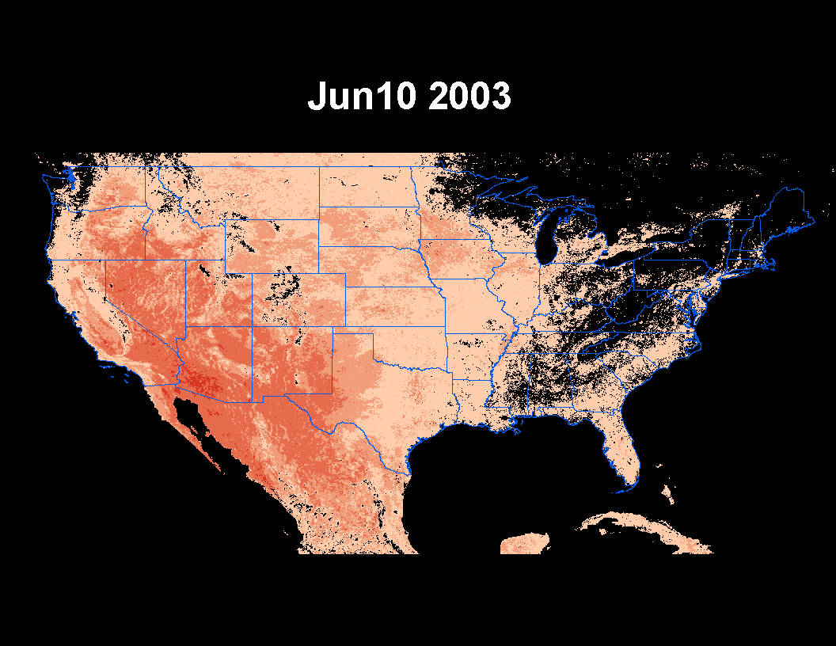
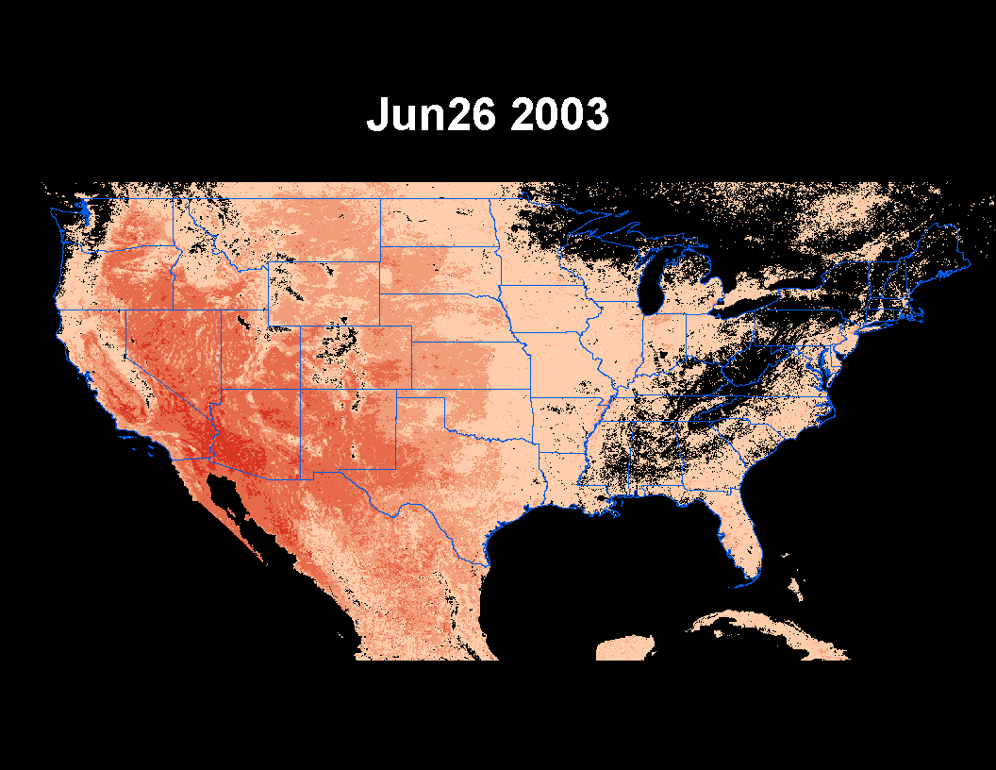
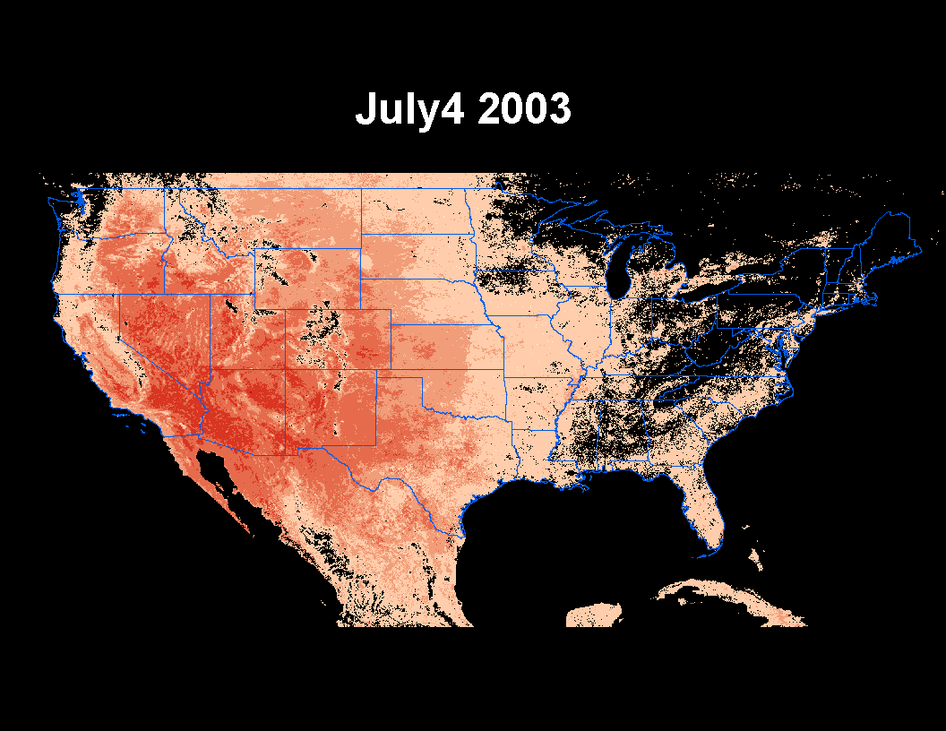
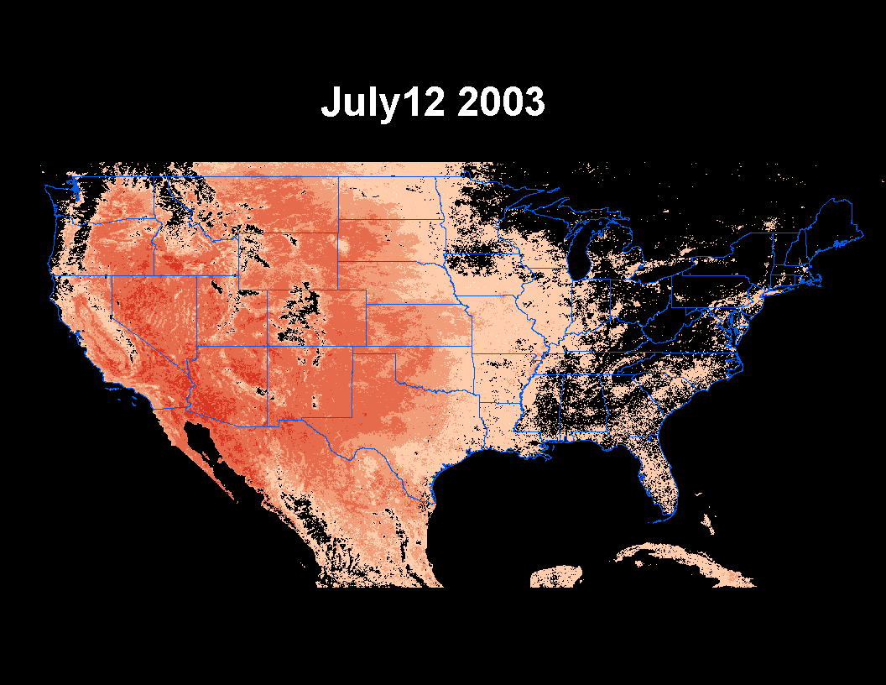

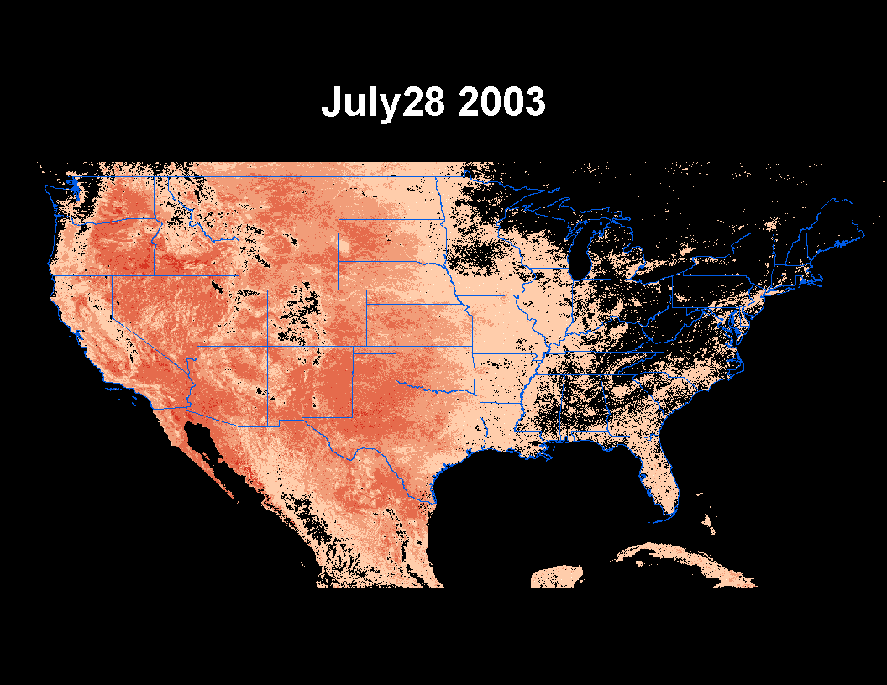
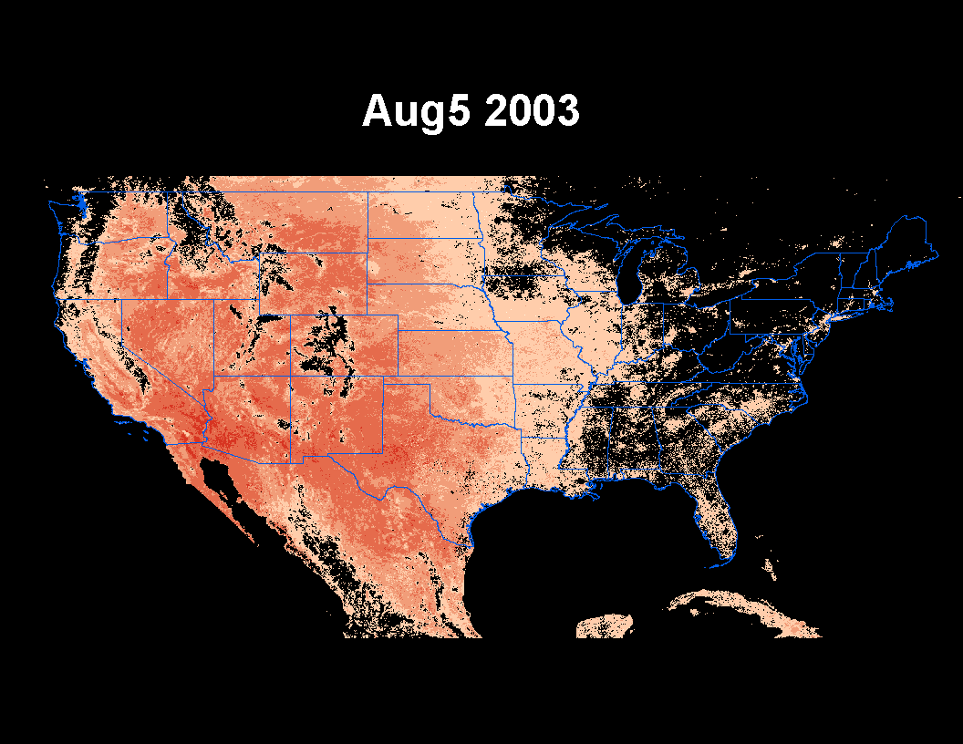
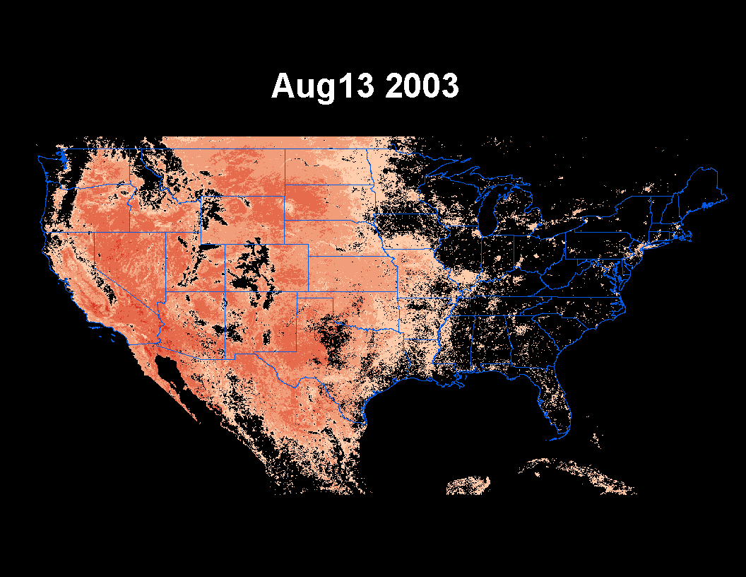
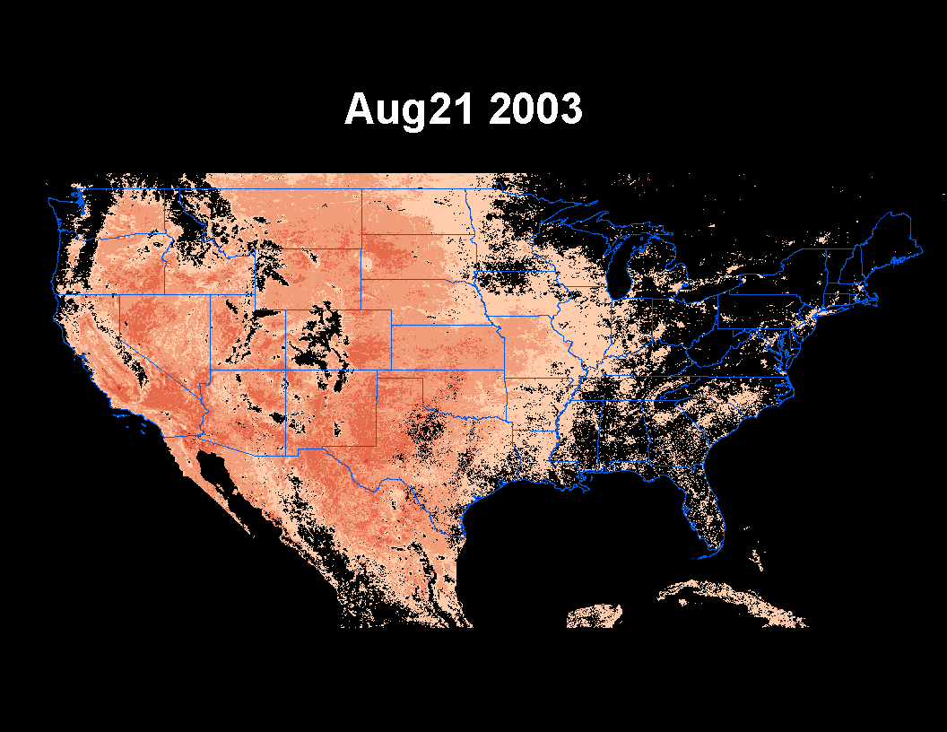
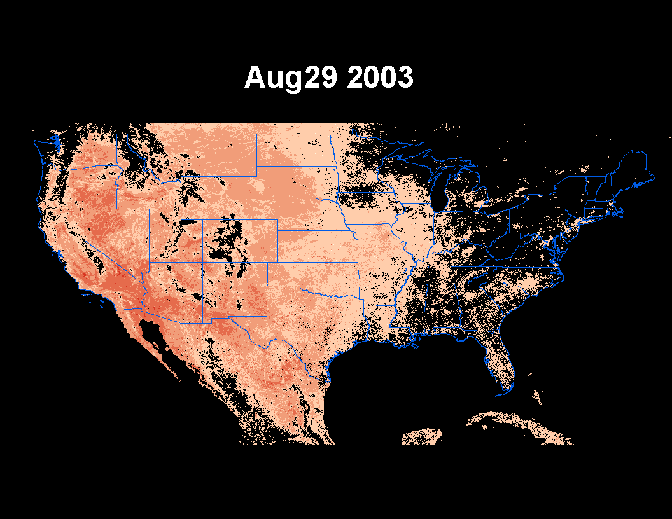
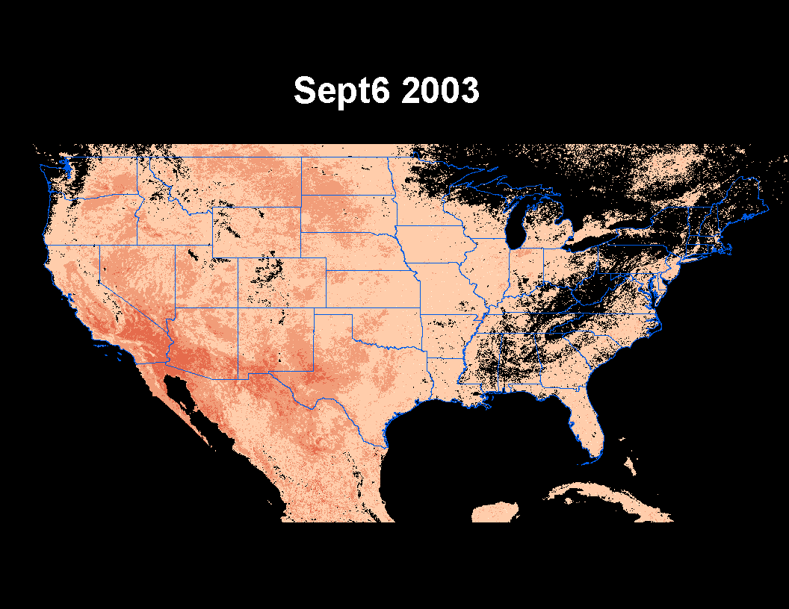
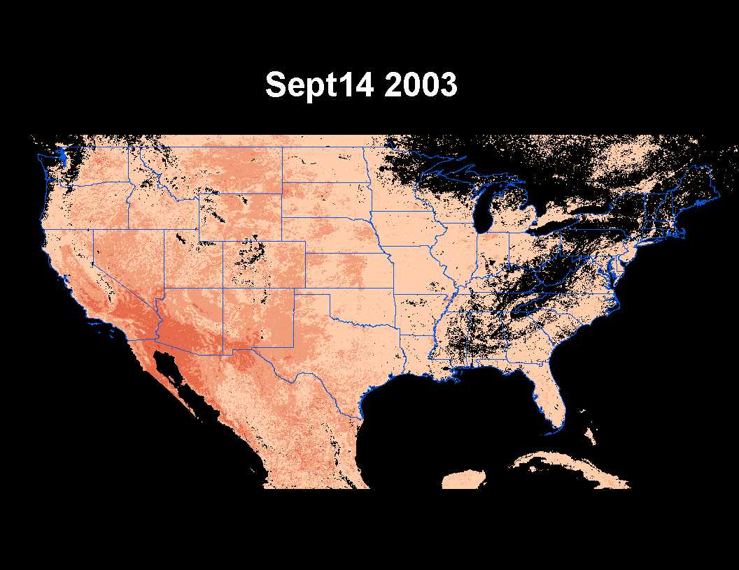
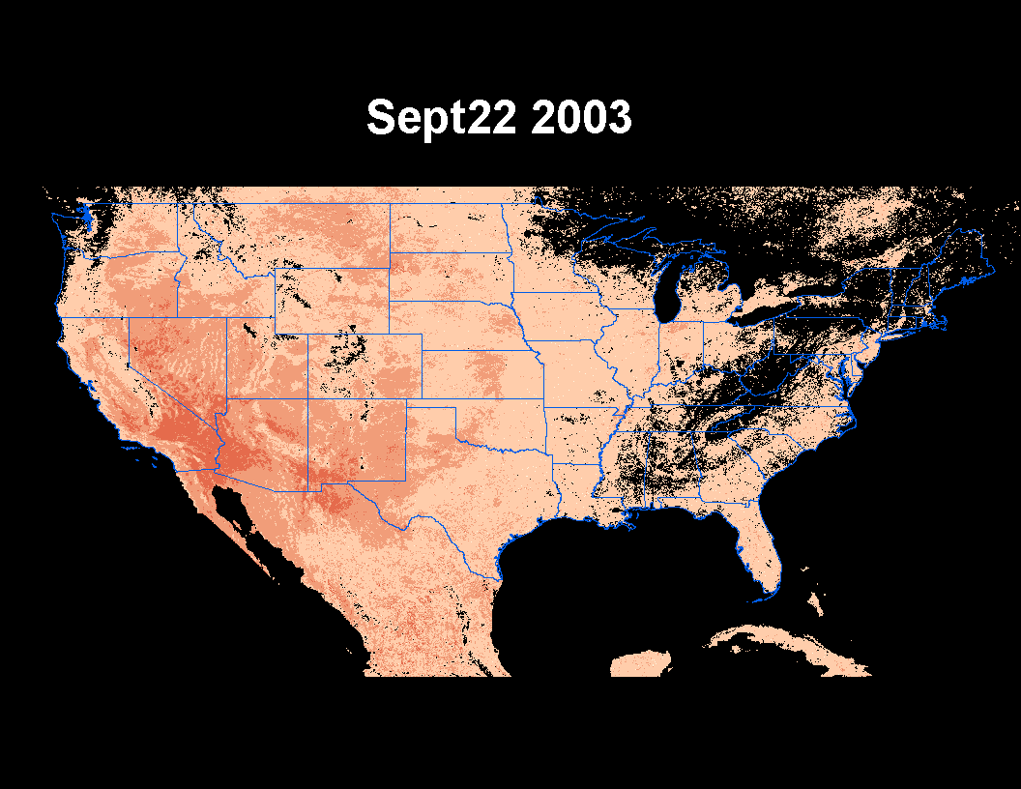
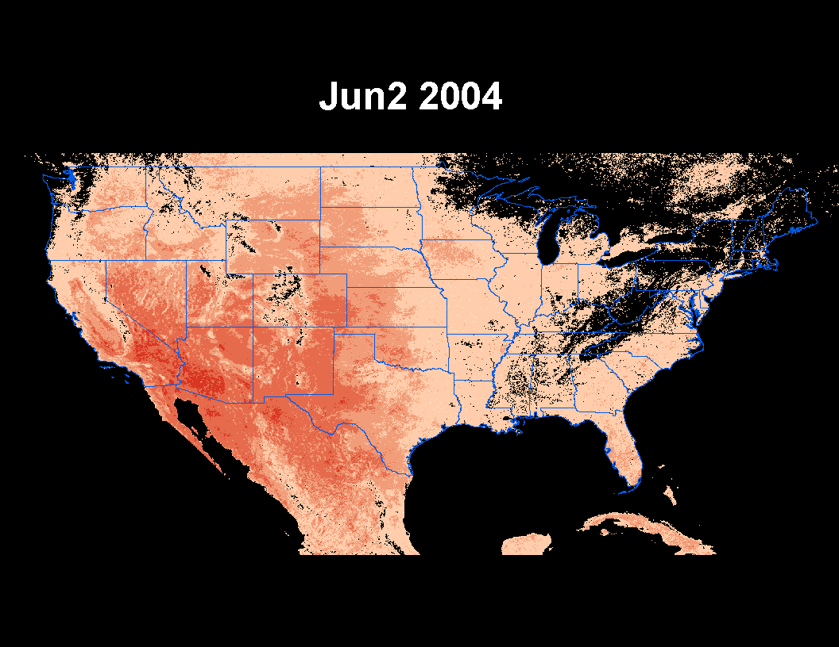
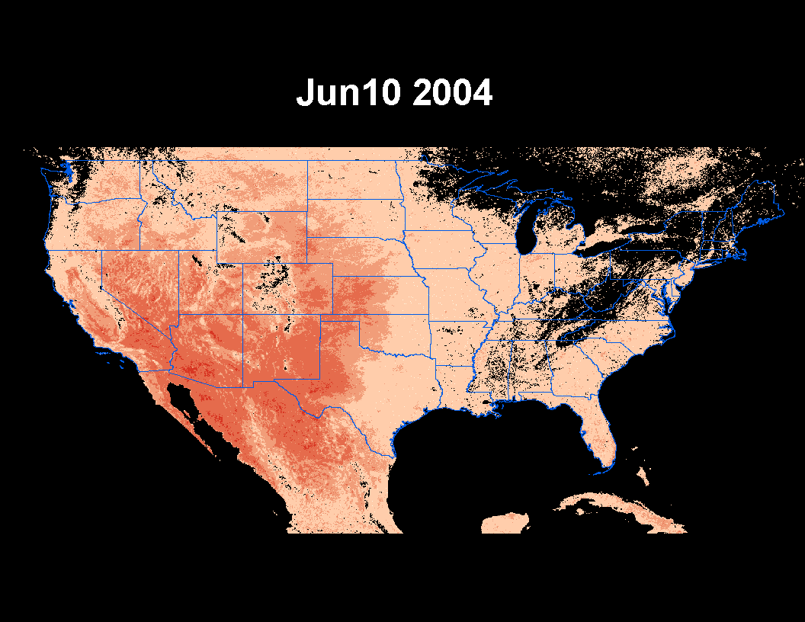
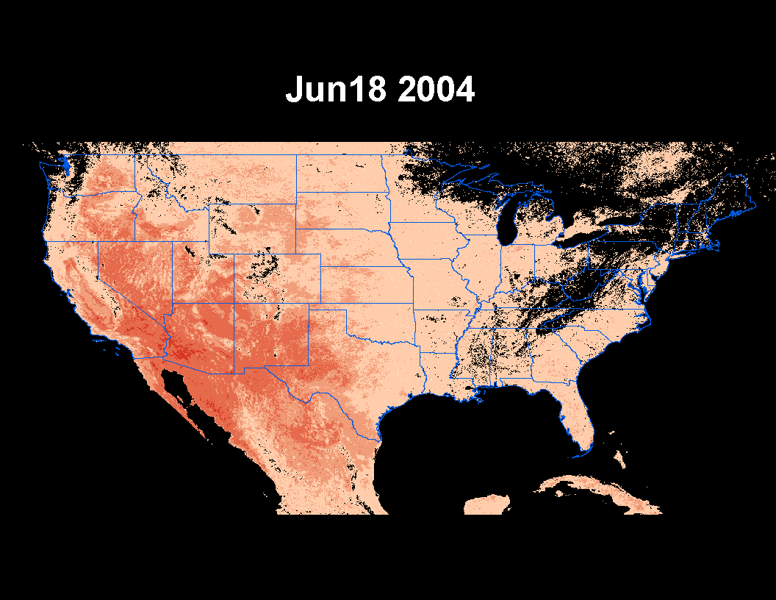
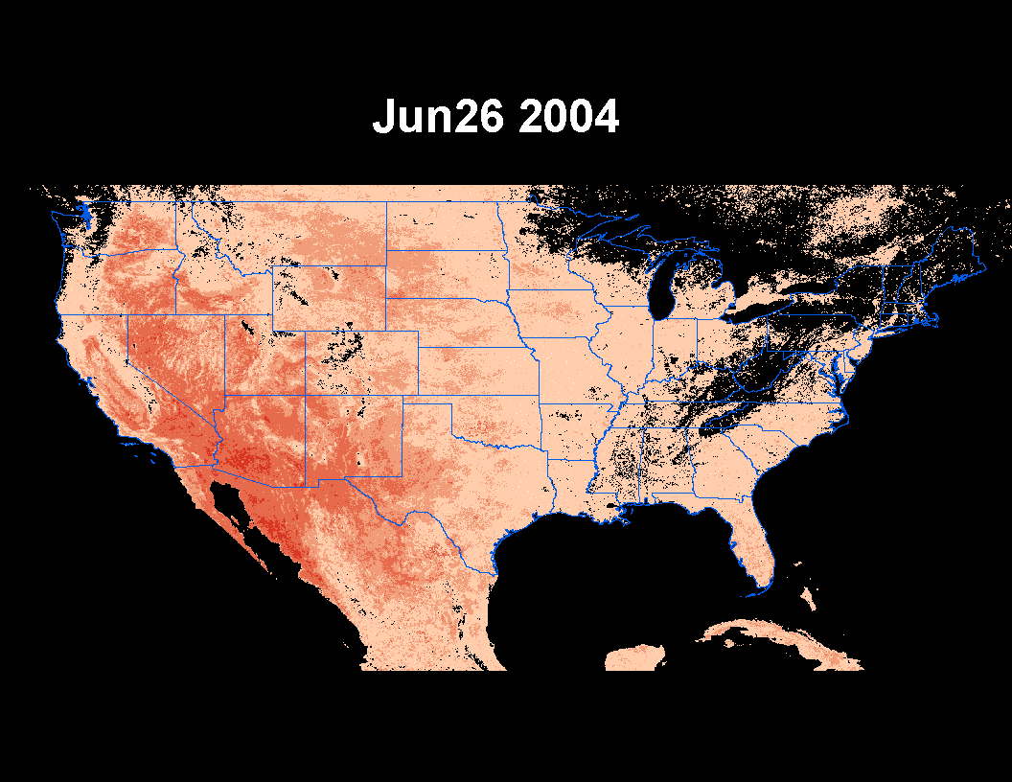

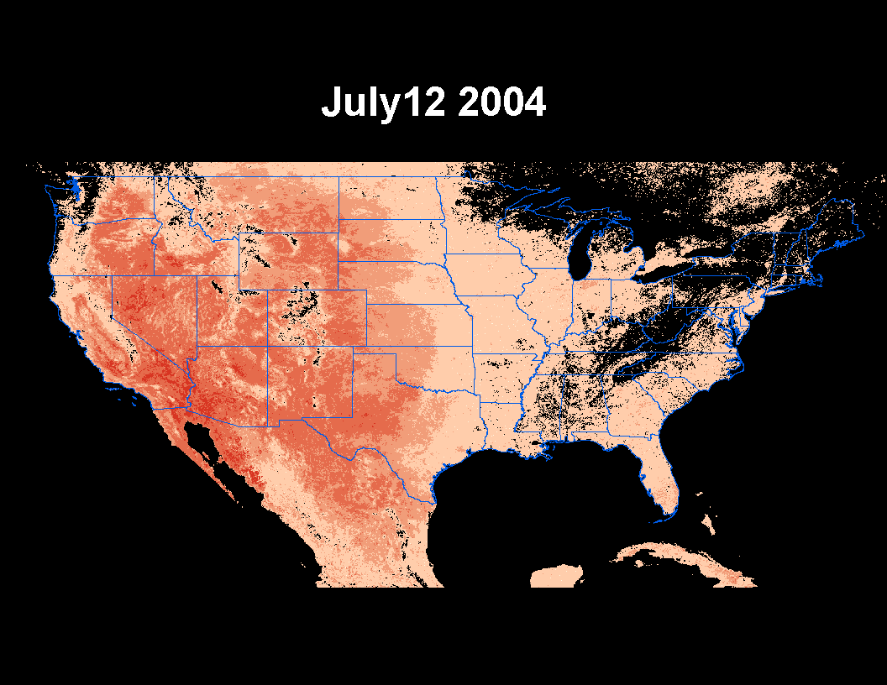
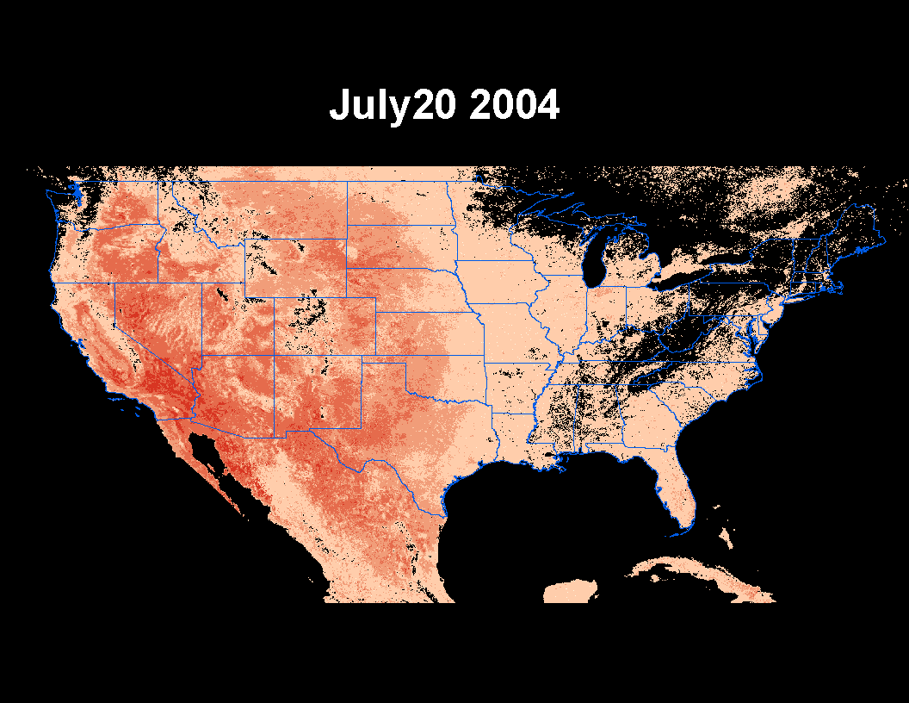
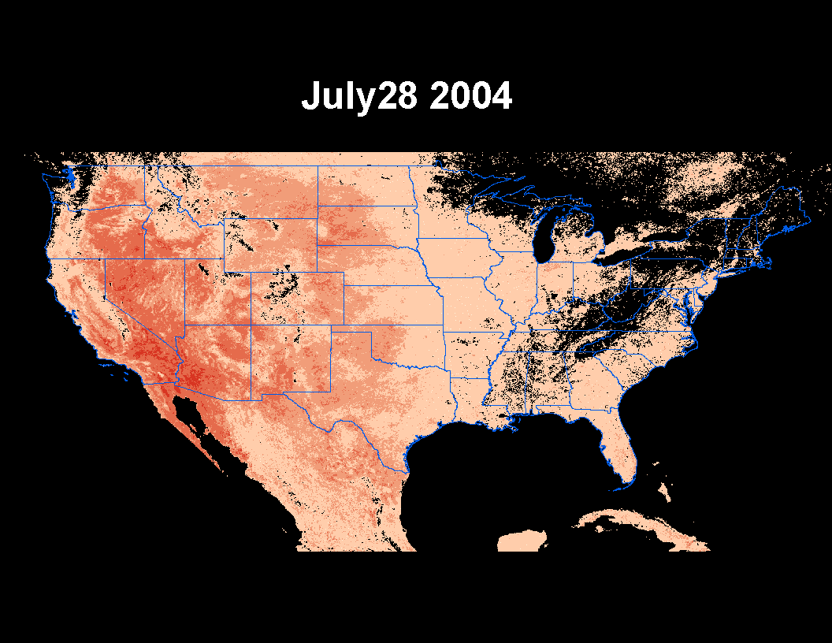

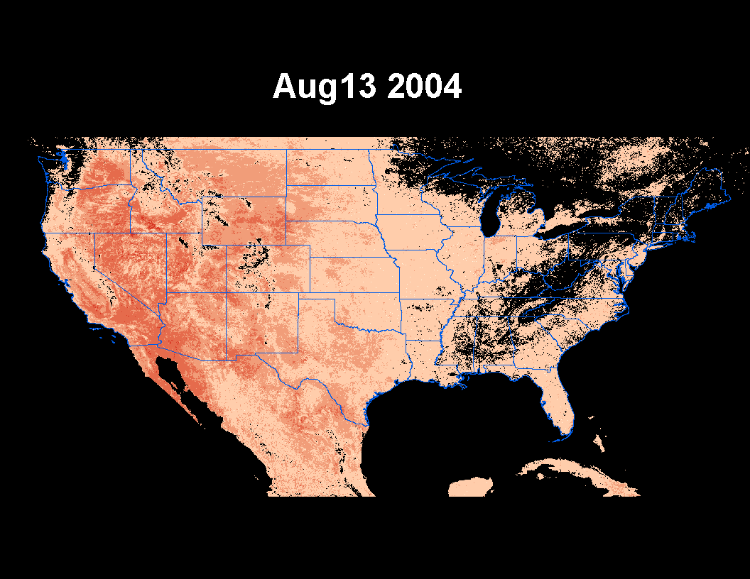
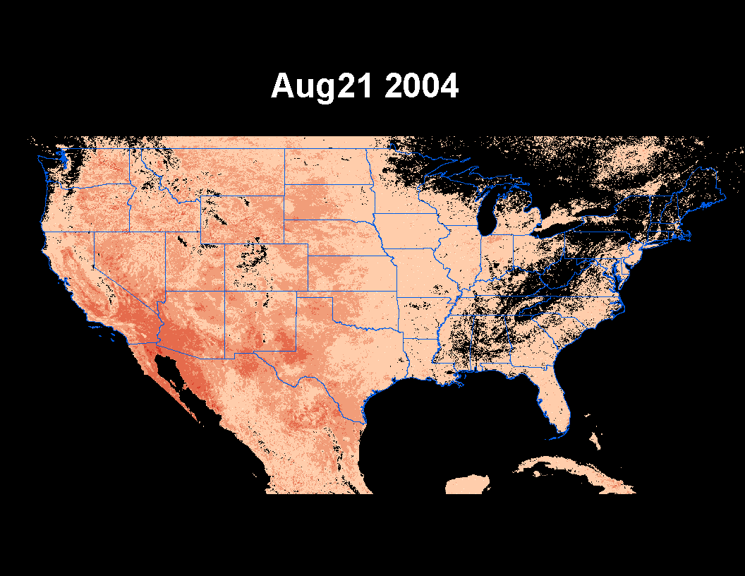
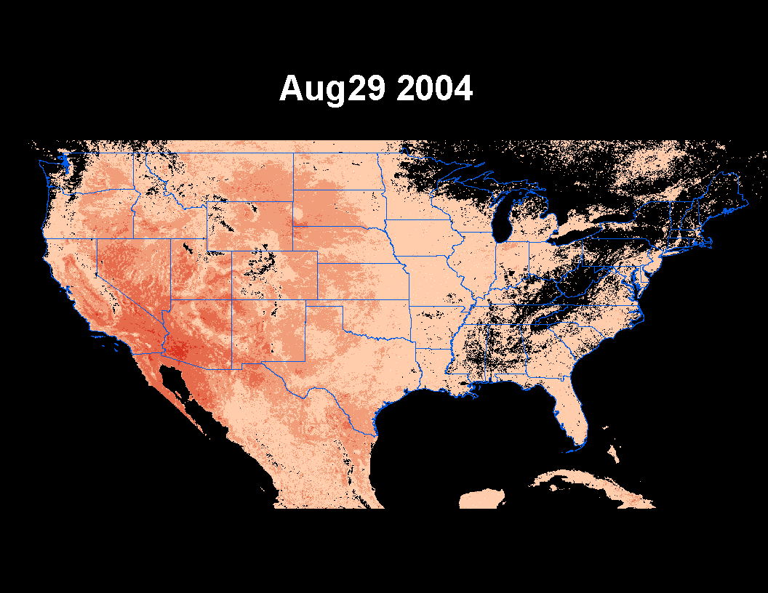

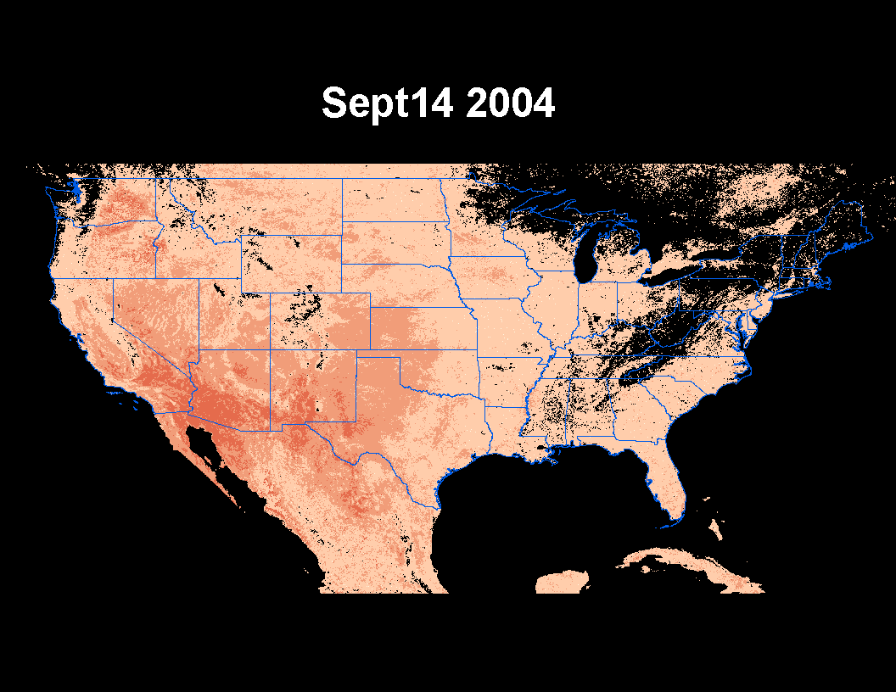


Slide 32
Project 3. Effect of snow cover on aphid populations and control by their natural enemies
Repeat the procedure for over-wintering processes
Over-wintering is very rarely investigated for insects
time
organization
space

Slide 33
Project components
1. Rapid evolution to environmental change
2. Co-evolution among insects and symbionts
3. Effect of temperature on aphid populations and control by their natural enemies
4. interplay between ecological and evolutionary dynamics
time
organization
space

